Slide 1

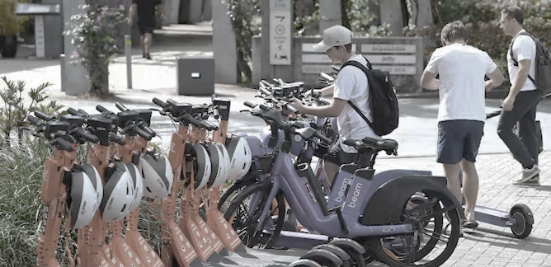

Next Hikes IT Solutions
July 2025
Bike Sharing Demand Analysis Project Using Excel
Abdus Samad

Slide 2

Bike Sharing Demand Analysis
The goal of this project is to analyze and visualize bike-sharing demand trends by leveraging advanced Excel tools for data preprocessing, statistical analysis, and interactive dashboard creation.
Extract meaningful insights from hourly and daily rental data using pivot tables, charts, conditional logic, and formulas.
Understand the impact of weather conditions, seasonal variations, and user types (registered vs. casual) on rental behavior.
Analyze patterns and trends to support data-driven decision-making across planning, marketing, and operational strategies.
Ultimately, the project aims to optimize resource allocation and improve service efficiency for the bike-sharing system.

Slide 3

Data Preparation & Merging
Cleaned data: Removed duplicates, Missing Value, formatted date, added fields.
Merged datasets using 'instant', 'dteday', with Power Query.
Created new columns: Total Rentals, Day Type, Weekend Flag Etc.
Ensured data integrity by removing errors, merging records, and standardizing fields for precise analysis.

Slide 4
Analysis, Dashboarding & VBA Automation
Used formulas: SUMIF, COUNTIF, STDEV, CORREL for calculations.
Created pivot tables for time, user, and weather trends.
Designed interactive dashboard with slicers and charts.
Created macro to refresh all pivot tables and apply formatting.
Linked macro to 'Refresh & Format' button on dashboard.

Slide 5
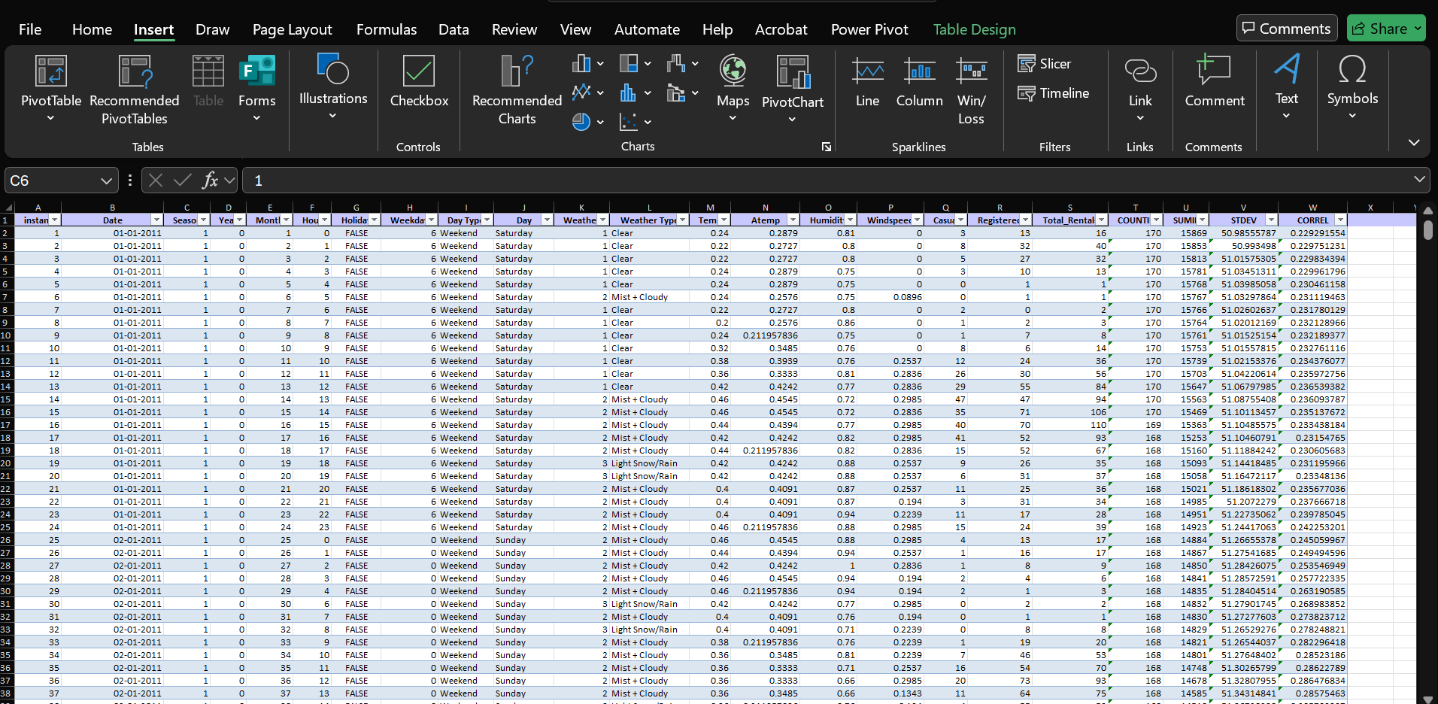
Data After Preprocessing
Structured data enabled accurate visualizations and deeper time-wise analysis of rental trends.

Slide 6
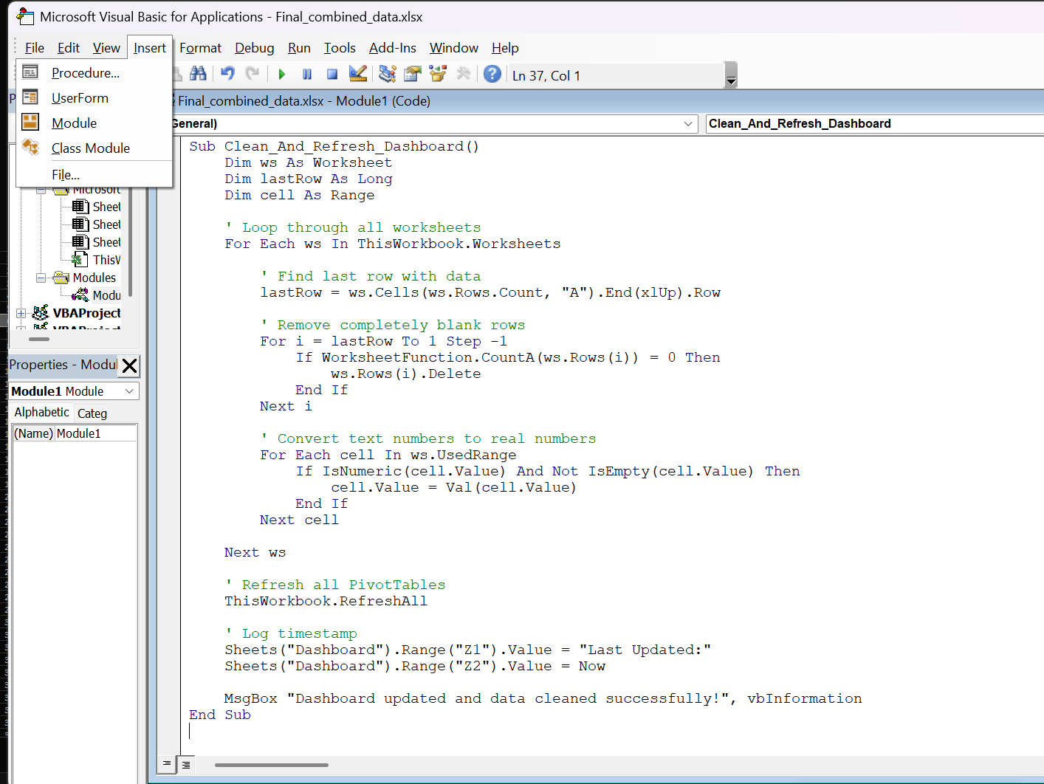
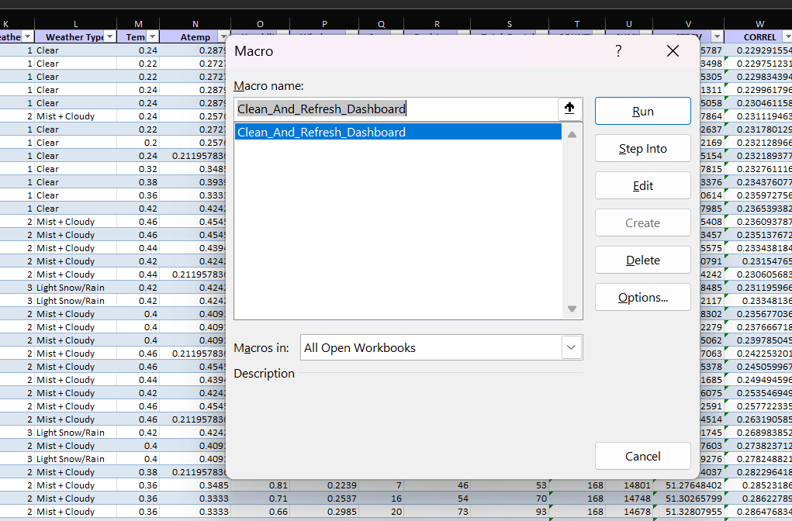
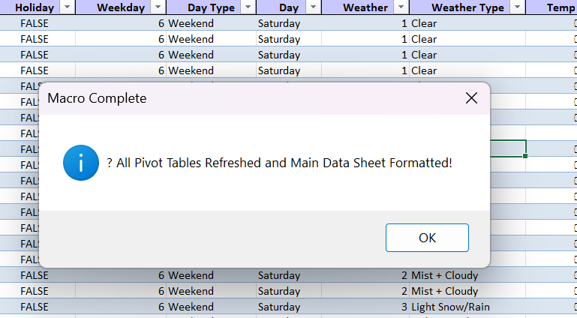
Launching the VBA Editor and Running Code
Amount
Number of years

Slide 7
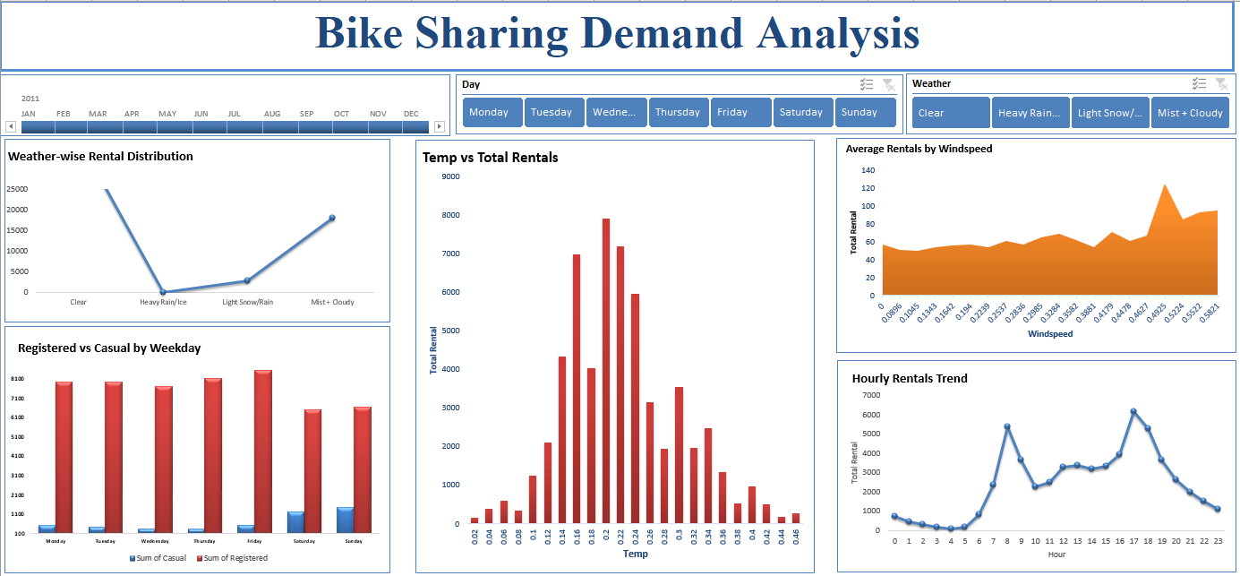
Overall Dashboard Layout
Monthly Timeline Slicer
Weather Filter Buttons
Weather-wise Rentals
Hourly Rentals Trend
Interactive dashboard provides real-time insights across key rental factors — Hourly, weather, and Temperature.

Slide 8
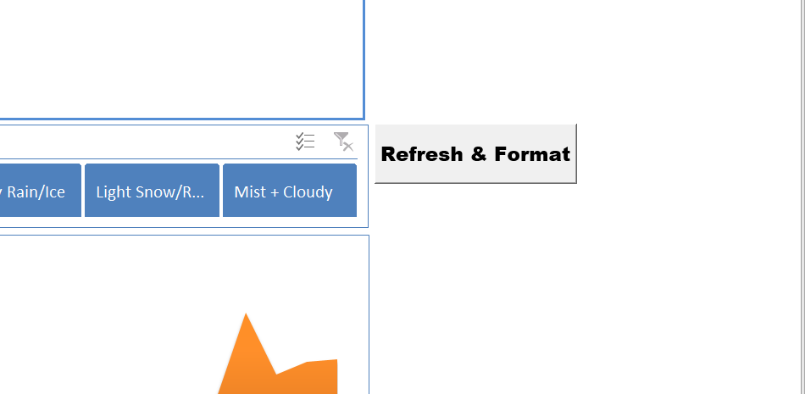
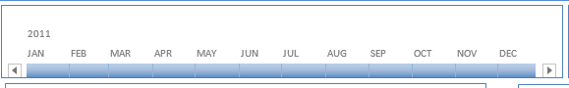
Click to Auto-Refresh Pivots & Charts
Automated reporting with a single click — refresh all pivots and update formatting instantly.
Weather Filter Buttons
Amount
Visual weather buttons allow intuitive filtering to compare demand in clear vs adverse conditions.
Month Selection for Analysis
Monthly slicer empowers dynamic filtering and seasonality analysis in just one click.

Slide 9
Key Insights
Rentals peak during 8–9 AM & 5–6 PM (Rush Hours).
Higher rentals on weekends vs weekdays.
Morning and evening rush hours mark demand spikes — crucial for rebalancing efforts.
More casual users on weekends, registered users dominate weekdays.

Slide 10
Key points
• Hourly demand shows clear commuting patterns (morning & evening peaks).
• Temperature and humidity significantly influence rental activity.
• Higher windspeed correlates with reduced rentals.
• Registered users ride more on weekdays; casual users on weekends.
• Weather and time-based strategies can boost marketing and resource planning.

Slide 11
Conclusion
This Excel-based analysis provided valuable insights into bike rental behavior. With interactive dashboards and automation, business teams can now make faster, data-backed decisions with minimal manual effort.

Slide 12
Thanks

